Slide 1
A Topological Hierarchy for Functions on Triangulated Surfaces
Authors: Peer-Timo Bremer, Herbert Edelsbrunner, Bernd Hamann and Valerio Pascucci
Presenter: Yansong Yu
Date: 07/16/2024

Slide 2
Contents
Backgrounds
Method
Result

Slide 3
Backgrounds
Manifold
Morse functions
Morse-Smale Complexes
Piecewise linear functions
Persistence

Slide 4
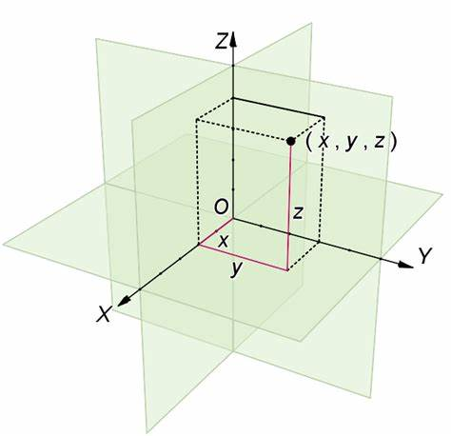




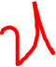













































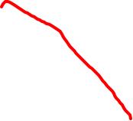



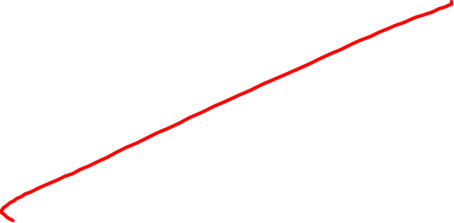













Manifold
In mathematics, a manifold is a topological space that locally resembles Euclidean space near each point.
More precisely, an n-dimensional manifold (n-manifold for short), is a topological space with the property that each point has a neighborhood that is homeomorphic to an open subset of n-dimensional Euclidean space.
Topological space
Manifold
Notes:
Compact: closed & bounded

Slide 5





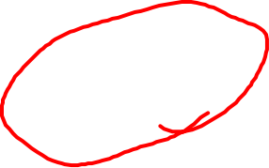













Manifold
Topological space: {X, T}
X is a set
T is a subset of P(X)
T must meet the requirements:
Φ in T.
X in T.
The intersection of a finite number of sets in T is also in T.
The union of an arbitrary number of sets in T is also in T.
Topological space: a set X paired with T (a topology of X).
Example:
X=R¹, T={U | U is the union of Open intervals}, T is the standard topology of X
X=R², T={U | U is the union of Open neighbourhoods}, T is the standard topology of X
X={1, 2, 3}, then T₁={Φ, X}, T2={Φ, X, {1}, {2}, {1, 2}}, T=P(X)...
Notes:
Compact: closed & bounded

Slide 6
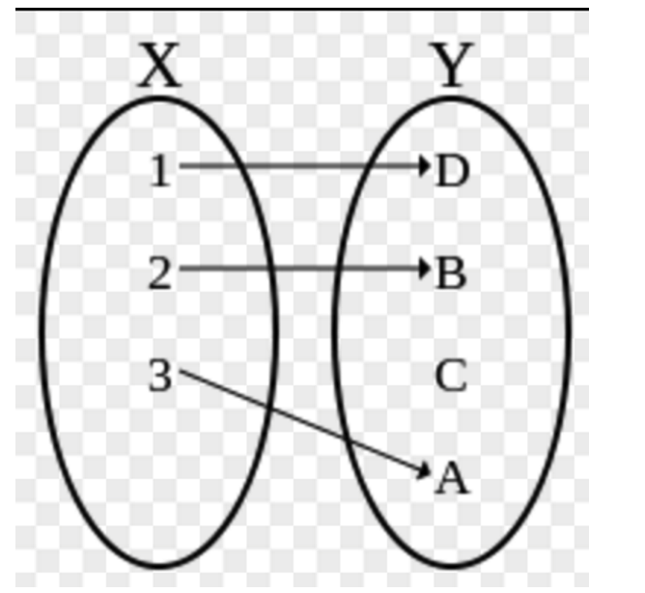
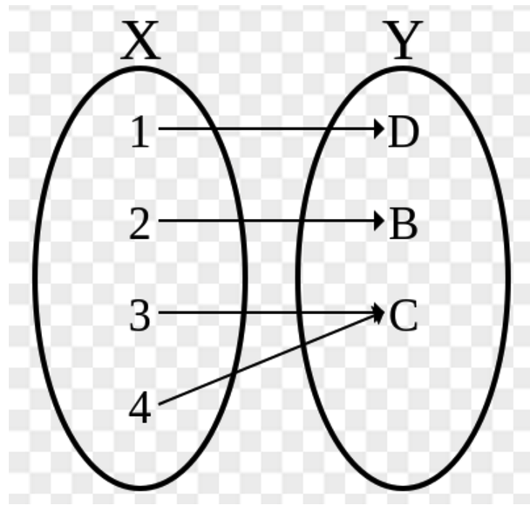
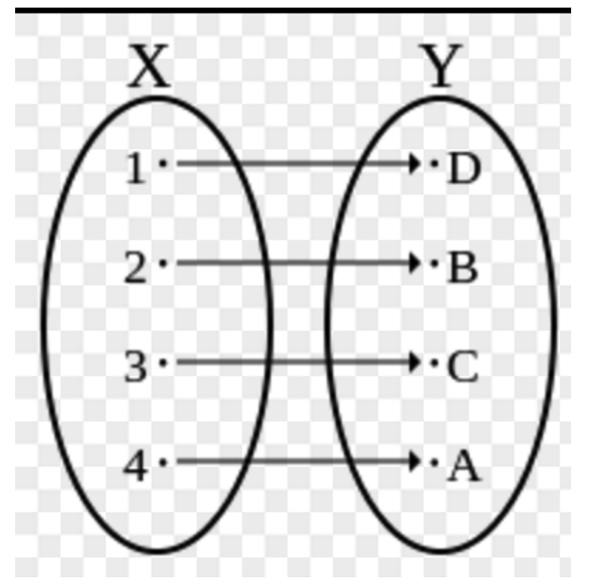
Manifold
Homeomorphism:
A function f: X→Y between two topological spaces is a homeomorphism if it has the following properties:
f is a bijection (each points in Y have a preimage in X AND preimages are different with each other).
f is continuous.
f⁻¹ is continuous.
If this function can be found, then X and Y are homeomorphic.
one-to-one/injection
onto/surjection
bijection

Slide 7
Manifold
Open set:
Each point in this set is neighborhood point, in other words, each point is inside the set (not on the boundary).
Examples:
(a, b) is an open set, [a, b], (a, b], [a, b) are not.
{(x, y) | x^2 + y^2 < 1} is an open set, {(x, y) | x^2 + y^2 <= 1} is not.

Slide 8

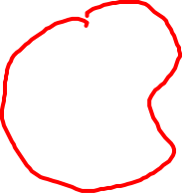
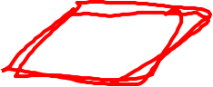





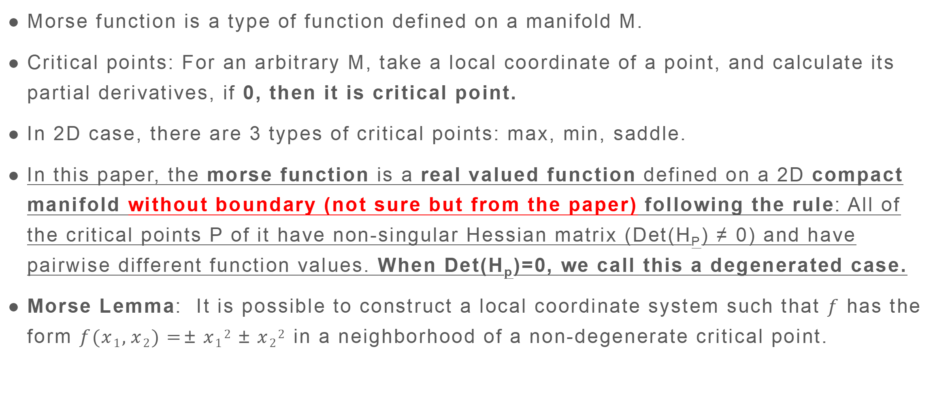
Morse functions
Morse function is a type of function defined on a manifold M.
Critical points: For an arbitrary M, take a local coordinate of a point, and calculate its partial derivatives, if 0, then it is critical point.
In 2D case, there are 3 types of critical points: max, min, saddle.
In this paper, the morse function is a real valued function defined on a 2D compact manifold without boundary (not sure but from the paper) following the rule: All of the critical points P of it have non-singular Hessian matrix (Det(H_{P}) ≠ 0) and have pairwise different function values. When Det(H_{p})=0, we call this a degenerated case.
Morse Lemma: It is possible to construct a local coordinate system such that $f$ has the form $f(x1,x2)=±x12±x22$ in a neighborhood of a non-degenerate critical point.

Slide 9
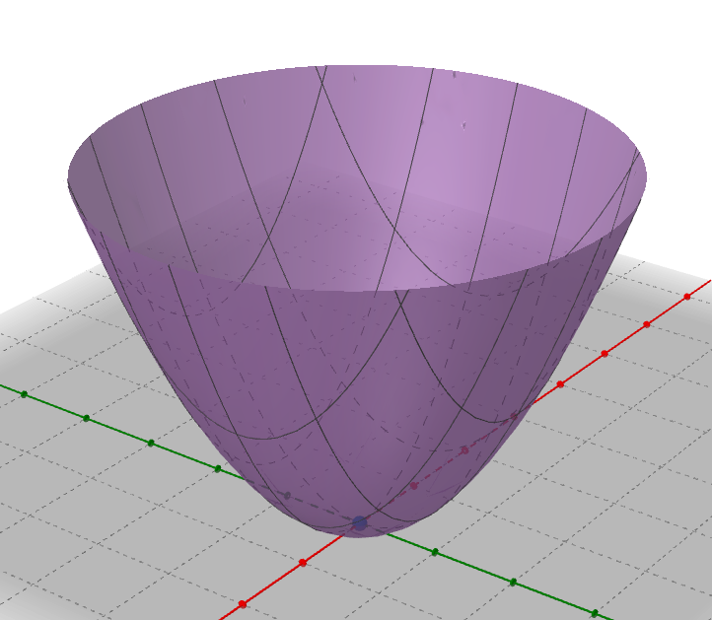
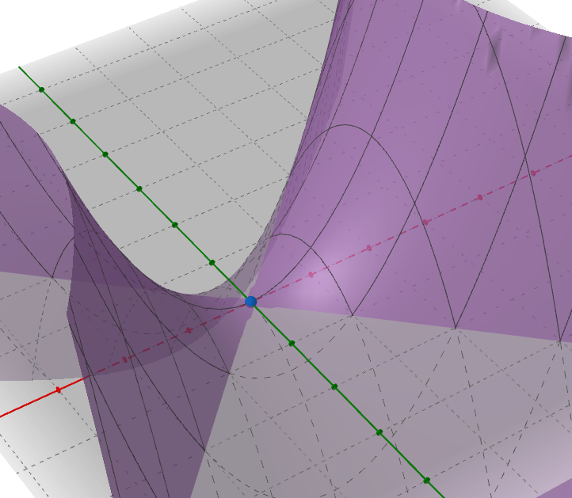
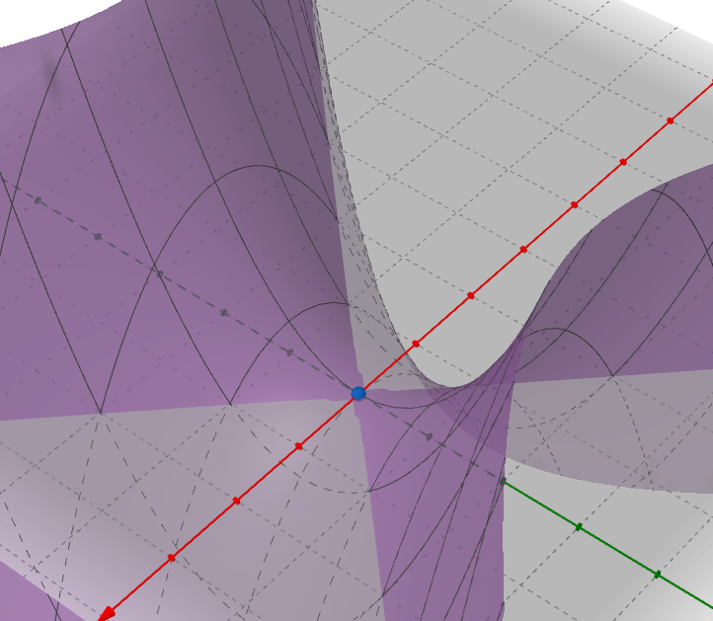
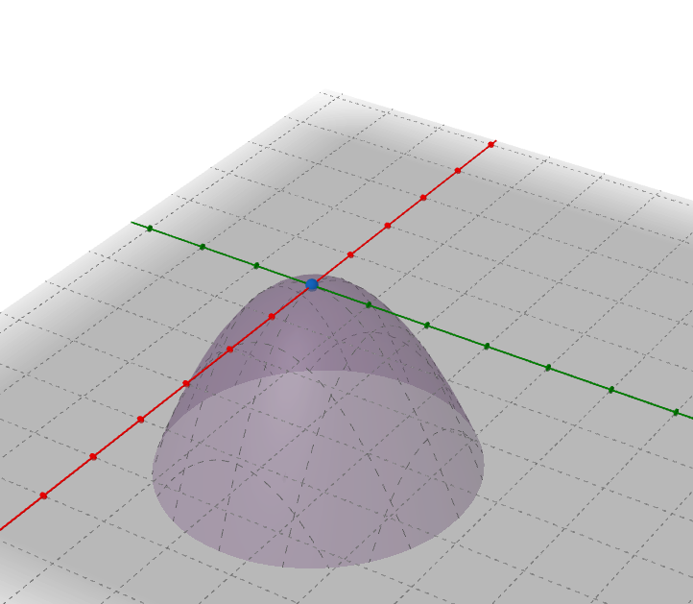

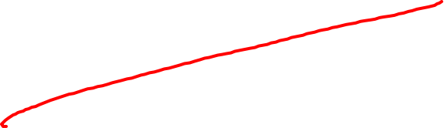












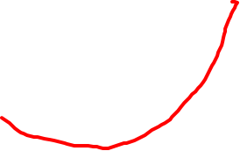

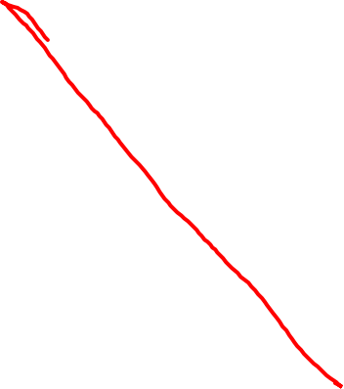

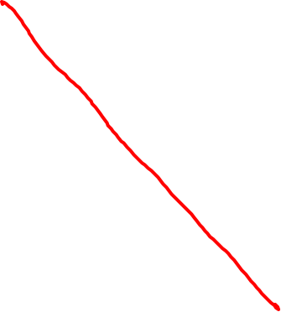









Morse function
Follow the Morse Lemma, the local representation of f at the neighbourhood of non-degenerated critical points are shown below.
f(x₁, x₂)=x₁²+x₂²
f(x₁, x₂)=x₁²-x₂²
f(x₁, x₂)=-x₁²+x₂²
f(x₁, x₂)=-x₁²-x₂²
critical index = the number of the “-” in the local representation
Notes:
The number of negative eigenvalues of Hassian matrix at this point.

Slide 10
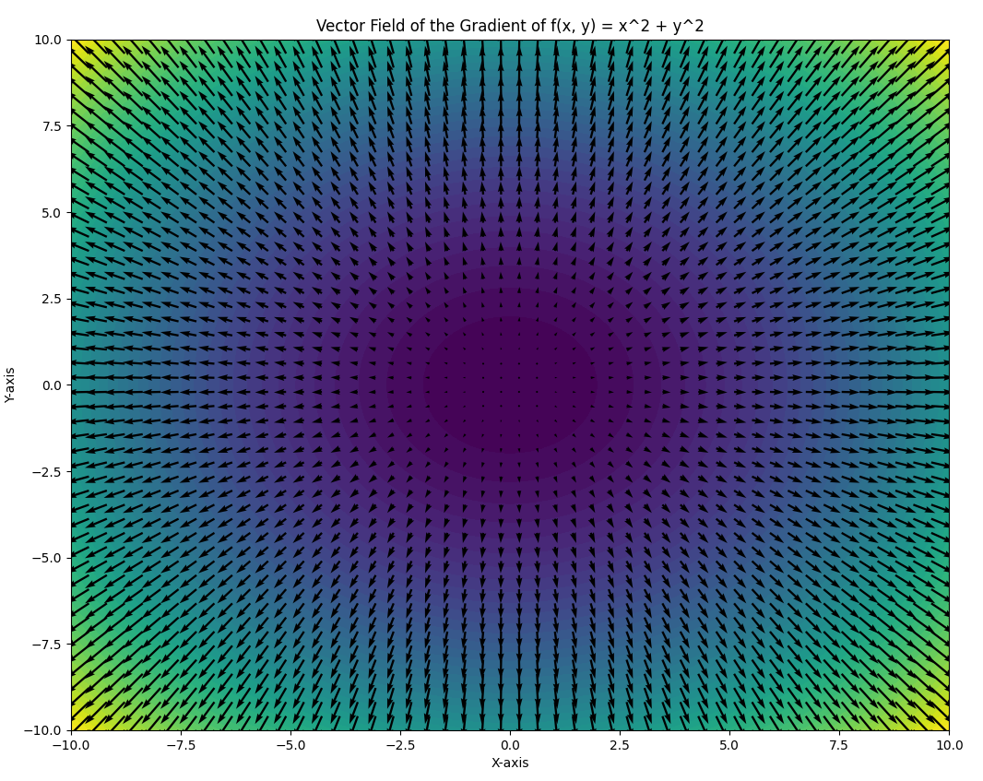
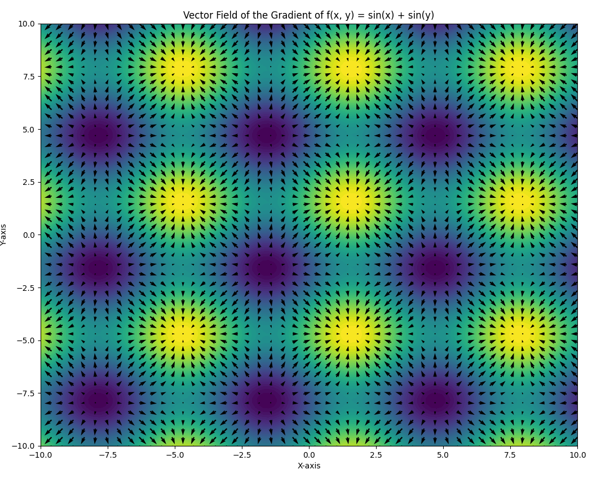








Morse-Smale Complexes
The gradient of a 2D function, for example, f(x, y) = x^2 + y^2 and f(x, y) = sin(x) + sin(y), form vector fields.
∇f = (2x, 2y)
∇f = (cos(x), cos(y))

Slide 11
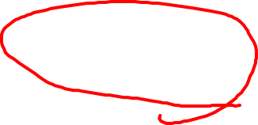





Morse-Smale Complexes
From a gradient field like this, we start from a point whose gradient is not 0, then we follow the ∇f and -∇f, then we can get a integral line whose two ends should both be critical points (and technically, the line doesn’t contain either of the critical points).
Since the line follow the gradient, so the line is monotonic, so the 2 criticals are not the same.
∇f
starter point
∇f = (cos(x), cos(y))
-∇f

Slide 12


Morse-Smale Complexes
We can trace multiple integral lines in the function domain (a 2-manifold), and after trace all the integral lines, the integral lines will cover the entire domain, except for the criticals. So basically, we can see three elements which are maximums, minimums, saddles and all integral lines.
∇f
starter point
∇f = (cos(x), cos(y))
-∇f

Slide 13














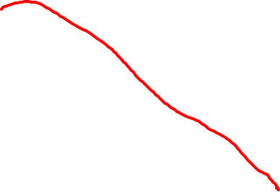












Morse-Smale Complexes
Here are two terms, in Morse-Smale Complexes.
Ascending manifold (A)
Descending manifold (D)
This two terms are used to describe two components for a critical point. For example, in 2D case, we have a critical point a, then, follow the ∇f:
A(a) = {a}U{all integral lines starting from a}
D(a) = {a}U{all integral lines ending at a}

Slide 14
Morse-Smale Complexes
For a continuous function, the integral lines traced will only intersect at critical points.
Specifically, same types of integral lines can only intersect at critical points (max, min and saddle), integral lines of different types can only intersect (or cross) at saddles.

Slide 15

Morse-Smale Complexes
We have all the integral lines that make up the ascending and descending manifold in the whole domain of function f(x, y), and every critical points. Based on the non-degeneracy prerequisit, the ascending and descending manifold can only intersect transversally (which means they cross at saddle points).
Then the Morse-Smale complex is constructed through the overlay of A and D.

Slide 16
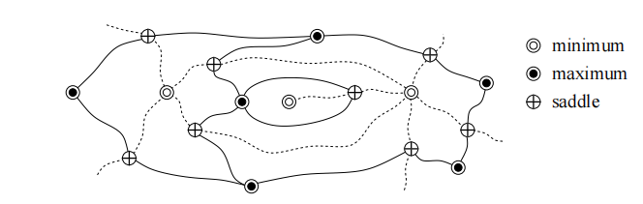





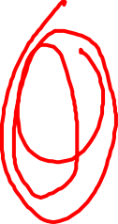




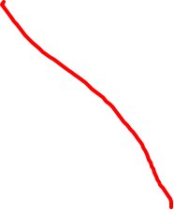
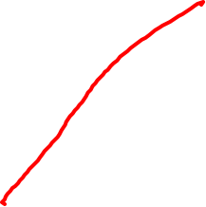
















































Morse-Smale Complexes

Slide 17









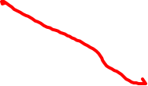












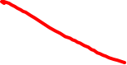





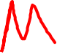

















Piecewise linear functions
Function defined on a finite set of points spread out over a manifold.
So each point has a function value attached to it. And we can connect the points to form a trianglular mesh K (2-manifold), and we can use piecewise linear interpolation for function values on edges and triangles.
Assumption: this PL function has pairwise different values.
Not Smooth

Slide 18
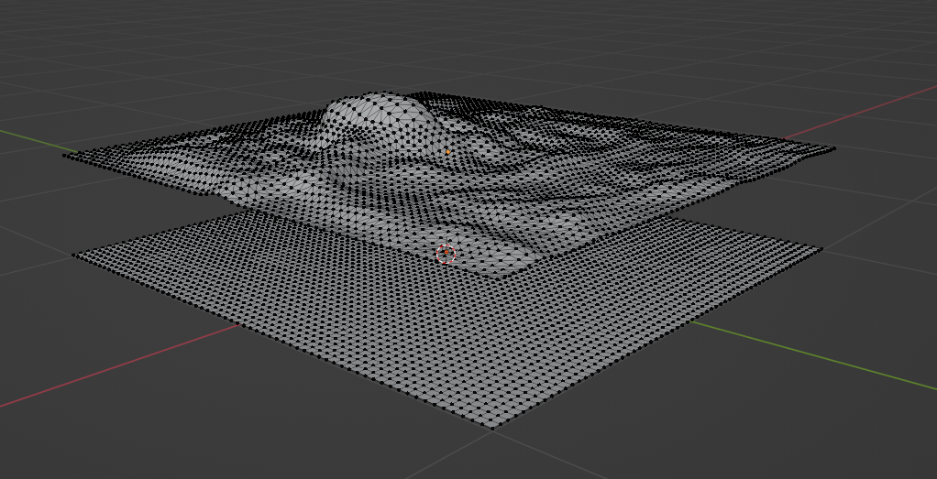
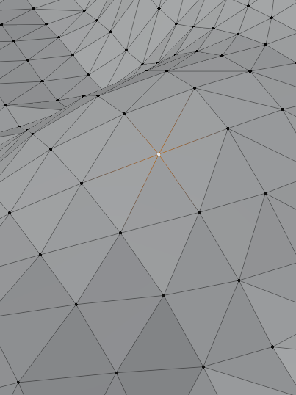



























Piecewise linear functions
Star: The star of a vertex u consists of all simplices (vertices, edges and triangles) that contain u, and the link consists of all faces of simplices in the star that are disjoint from u.
We have a PL function example here.
The PL function
The 2-manifold

Slide 19
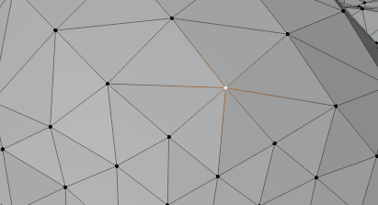














Piecewise linear functions
Lower star: The lower star contains all simplices in the star for which u is the highest vertex.
Upper star: The upper star contains all simplices in the star for which u is the lowest vertex.
Lower link: The lower link contains all simplices in the link whose endpoints are lower than u.
Upper link: The upper link contains all simplices in the link whose endpoints are higher than u.

Slide 20
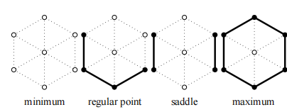

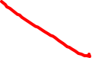














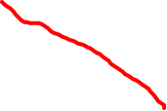





Piecewise linear functions
We can use the connected component of lower link and upper link to decide the type of a point.

Slide 21
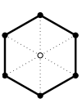
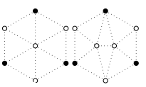











Piecewise linear functions
We can use the connected component of lower link and upper link to decide the type of a point.
1-fold saddle
2-fold saddle

Slide 22
Persistence
Also we can call it importance. It is a measure to tell how important a pair of critical points is.
The persistence of u and of v (both critical points):

Slide 23




















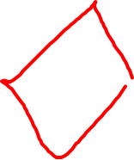









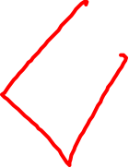







Method
Morse-Smale complex -- preprocess and construct a MSC
Hierarchy -- improve the performance
Geometric approximation -- refine each level of hierarchy
Remeshing -- remesh each MSC cell for better rendering

Slide 24
Morse-Smale complex
In the paper, this is called a preprocessing stage.
In this stage, based on a PL function dataset, a Morse-Smale complex is constructed.

Slide 25
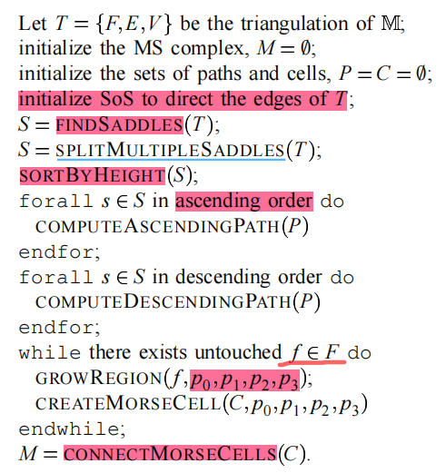





















































Morse-Smale complex
Explanation:
1. SoS (simulation of simplicity) here makes the PL function a Morse function;
2. SplitMultipleSaddles means we make all the saddles be 1-fold saddle.

Slide 26

Hierarchy
Their main objective is the design of a hierarchical data structure that supports adaptive coarsening and refinement of the data (MSC and PL function). In this section, they describe such a data structure and discuss how to use it.
Diagonals and diamonds
Cancellations
Node removal
Independent cancellations

Slide 27














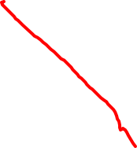






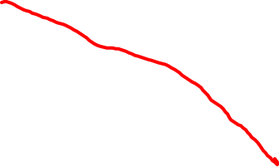
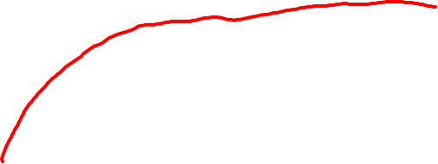
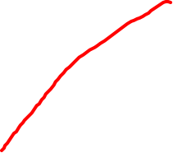



Hierarchy
Diagonals and diamonds:

Slide 28
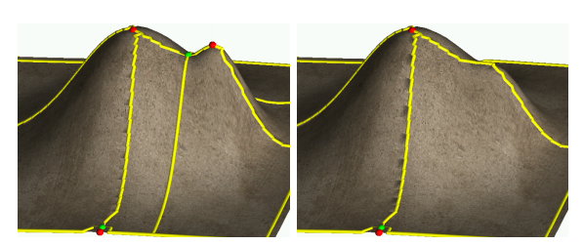
















Hierarchy
Cancellation: delete a pair of critical points
The pair of critical points needs to be adjacent in MSC, so the only combinations are:
<saddle, max>
<saddle, min>

Slide 29
Hierarchy
Cancellation: delete a pair of critical points
To perform a cancellation, we first look at a saddle, then if we want to delete saddle u and a maximun, then we check out the two maximum v and w connected to this saddle.
The requirement is that: if we want to delete <u, v>, then v≠w and f(v) < f(w)

Slide 30
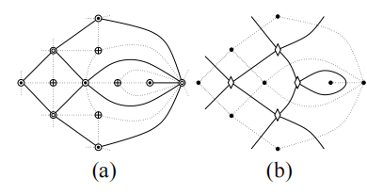



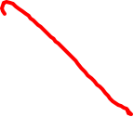





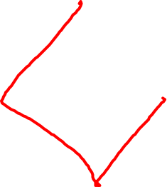












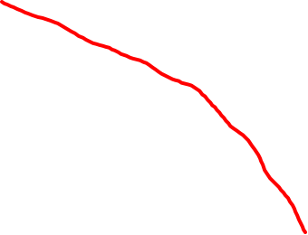
















Hierarchy
Node removal
From figure (a) and figure (b), they constructed a high level data structure for the cancellation operation.

Slide 31

Hierarchy
Node removal
From figure (a) and figure (b), they constructed a high level data structure for the cancellation operation.
Notes:
situation

Slide 32
Hierarchy
They construct the hierarchy by repeated cancellations.
Critical pairs: <s₁, v₁>, <s₂, v₂>, <s₃, v₃>, ..., <s_{k}, v_{k}> (ordered in ascending persistence)
For a layer of MSC and PL in the hierarchy, e.g. the j-th layer is after the cancellation of critical pairs <s₁, v₁> to <s_{j}, v_{j}>. So the 0-th layer is the original MSC and PL.
Notes:
situation

Slide 33
Independent cancellations
Two independent cancenllations A and B means that A and B does not share any vertices, they are interchangable, and A and B can be done simultaneously.
For example, there are k pairs of criticals, then the initial hierarchy is on the left having depth=k+1, and if independent pairs are deleted at once to form new layers, the hierarchy will be shallower.
1 pair of criticals
n_{cnt} pair of criticals
...
...
k
1 pair of criticals
<= k
n₂ pairs of criticals
1 pair of criticals
n₁ pairs of criticals
Base MSC
Base MSC

Slide 34
Geometric approximation
This is the process after each cancellation. After the cancellation, two criticals are removed, so the area contain the two criticals removed should be smoothed to monotonic and all the integral lines affected by the removal of these two criticals should be recomputed and smoothed.
1. Find all paths affected by a cancellation;
2. use the gradient smoothing to geometrically remove the
canceled critical points;
3. smooth the old regions until they are monotonic; (standard Laplacian smoothing)
4. erase the paths and re-compute new paths using the new
geometry;
5. use one-dimensional gradient smoothing to force the
new paths to comply with the constraints; and
6. smooth the new regions until all points are regular

Slide 35

Geometric approximation
This is the process after each cancellation. After the cancellation, two criticals are removed, so the area contain the two criticals removed should be smoothed to monotonic and all the integral lines affected by the removal of these two criticals should be recomputed and smoothed.

Slide 36
Remeshing
This steps purpose is for better integration into the rendering pipeline. Each Morse-smale region (patch) are triangulated with regular structure.
Path smoothing
Parametrization

Slide 37

Remeshing
Path smoothing: smoothing vertices and junction points on paths except for criticals.
For path vertices smoothing, I think they use gradient smoothing (paper does not mention), and for junction points, they use a modified laplacian smoothing.

Slide 38
Remeshing
Parametrization: This step is for constructing a regular structure for a MSC region (patch).
Map the boundary of the region to the boundary of one or multiple unit squares (param space)
Map the interior of the region to the param space (each vertex can be expressed as a convex combination of its neighbors. The coefficients in this combination can be computed by solving a sparse linear system).

Slide 39

Remeshing
After parametrization, they sample the parameter space on a uniform grid and use its preimage on M as a new mesh for the region.
Compute projected length to determine the corners, then using arc-length parametrization to determine other boundary points’ param coordinates
PCA
Preimages in M of the regular grid sampled in param space using mid-point subdivision
Notes:
principal component
analysis

Slide 40



Results
1. (Left) Original The Dalles data set containing 24,617 critical points.
2. (Right) Same data with 2,144 critical points after removing all topological features with persistence less than 0.1% of height range.

Slide 41


Results
Three different hierarchy construction strategy:
1. pure persistence:performing cancellations in order of increasing persistence.
2. performing simplification in “batches” of maximal independent sets of cancellations.
3. constructing maximal independent sets with a restricted range of
persistence values.
In all three methods, topology with persistence larger than 20% of the initial height range is not removed.

Slide 42

Results
1. (left) Highest resolution MS complex of Needles data set.
2. (middle) Node distribution over the levels for different cancellation strategies for Puget Sound data set.
3. (right) Number of critical points in MS complex during uniform refinement of Puget Sound data set.

Slide 43

Results
Nodes distribution over the levels for different cancellation strategies for the Yakima (left) , The Dalles (middle) , and the Needles (right) data sets.

Slide 44

Results
Number of critical points in MS complex for the Yakima (left), The Dalles (middle), and the Needles (right) data sets.

Slide 45

Results
(Left) Puget Sound data after topological noise removal.
(Middle) Data at persistence of 1 2% of the maximum height.
(Right) Data at persistence 20% of maximum height.

Slide 46

Results
(Left) View-dependent refinement of Puget Sound data (purple: view frustum).
(Middle) Combustion data after topological noise removal.
(Right) Adaptive refinement of combustion data based on function value. All maxima above 90% of the maximal function value are preserved.

Slide 47



Results

Slide 48

Appendix

